Slide 1
Racquetball Racket
Team 2:
Manaswini Rayappureddi
Pranav Sachdev
Ramya Chowdary Mupparaju
Venkatasai Varada
OPIM 5641-BUSINESS DECISION MODELLING

Slide 2
Agenda
Racquetball Industry
Market scenario
Business Case
Optimal ball price
Analyzing net profit with ball price
Analyzing net profit with investment
Risk Analysis
Varying competitor price and new ball price
Recommendations
OPIM 5641-BUSINESS DECISION MODELLING

Slide 3
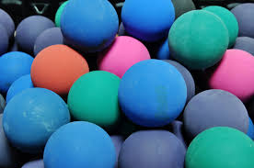
Racquetball Industry
Single Competitor
“Woodrow Ltd”
Unit Variable Cost $0.95
Sold as pack of 2 at $5
Unit retail price $2.5
Industry forecast
Growth in players - 10% for 10 years
Balls per Player-10
OPIM 5641-BUSINESS DECISION MODELLING

Slide 4
Market Scenario
OPIM 5641-BUSINESS DECISION MODELLING

Slide 5

Business Case
Parameters of new ball
Variable cost / ball | $0.52
Initial investment cost | $4 million
Funding | Bank Loan
Interest rate | 10%
Features of new ball
More bouncier
Less Durable
Low production cost
Is the manufacturing plant is a good investment?
What should be the optimized ball price?
How will competitor price change will effect us?
Market Ratio
Price Ratio | % who would buy
0.5 | 0
1 | 11
1.5 | 41
2 | 76
2.5 | 95
3 | 100
OPIM 5641-BUSINESS DECISION MODELLING

Slide 6
OPTIMAL Ball Price
$1.25
NPV is Positive
Profit shows an increasing trend
Loan is cleared in 10 years
OPIM 5641-BUSINESS DECISION MODELLING

Slide 7
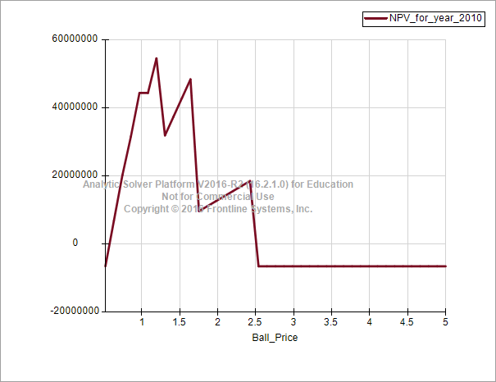
Analyzing NET Profit with ball price
Optimized Ball price $1.25
Price of ball varying from $0.52 - $5
Competitor ball price is $2.5
OPIM 5641-BUSINESS DECISION MODELLING

Slide 8
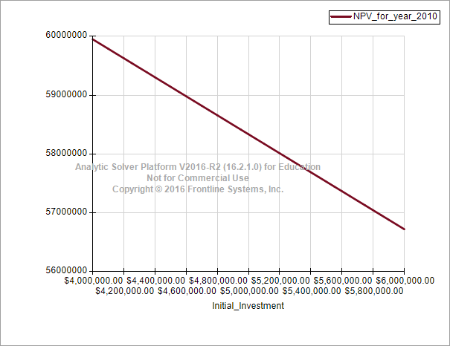
Analyzing net profit with Investment
Investment varying from $4M - $6M
Our Ball price - $1.25
Competitor price is $2.5
OPIM 5641-BUSINESS DECISION MODELLING

Slide 9
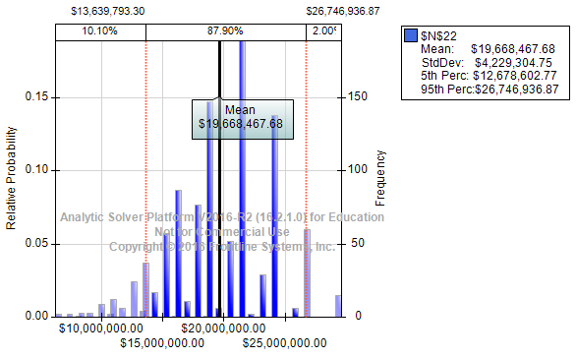
Risk Analysis – Varying Competitor Ball price
Competitor ball price varying –
Most likely – 2.5
Min: 0.95
Max: 2.5
Our Ball price - $1.25
OPIM 5641-BUSINESS DECISION MODELLING

Slide 10
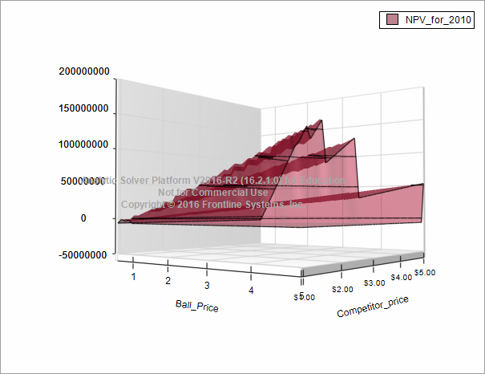
Varying ball price – own and competitor
Price of new ball varying from $0.52 - $5
Price of competitor’s ball varying from $0.95 - $5
OPIM 5641-BUSINESS DECISION MODELLING

Slide 11
Recommendations
Investment in the manufacturing plant seems to be a favorable endeavor
New ball should be rolled out in the market with a selling price of $1.25
If competitor maintains status-quo (selling price of $2.5/ball) - new ball price could vary between $0.63 - $2.42
Initial investment varied between $4 - $6 million, net profit (at the end of 10 years) remains positive – drops from $60 million to $56.5 million
Competitor responding to the new market entry – net profit would be about $19 million
OPIM 5641-BUSINESS DECISION MODELLING

Slide 12

THANK YOU
OPIM 5641-BUSINESS DECISION MODELLING

